Slide 1
Computer Viruses and security threats of the web
Supervisor: Ben Mora
By Dominic Chim (809400)

Slide 2
What is a Computer Virus
Not to be confused with a Worm or Trojan
In essence computer viruses are self-replicating computer programs which install themselves without permission
It populates area of the system causing it to be “infected”[1]

Slide 3
Bit of Background
First computer virus was written on a apple II circa 1982 by Rich Skrenta[2]
Dr Fredrick Cohen is the “father” of computer viruses[3]
However the introduction of virus-like programme were introduced in 1970’s with the Creeper virus[4]

Slide 4
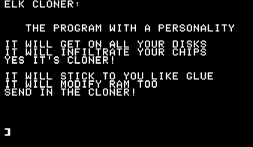
What they are used for
Most notably bad things
However there are other uses as well[5]
Fun
Experimentation
Demonstrate security threats
Famous example is the Elk Cloner virus

Slide 5
Types of Computer Viruses
Worms
Logic Bombs
Spammers
Keyloggers
Exploits

Slide 6
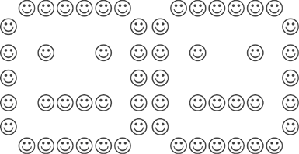
Intentions of Computer Viruses
To Destroy files
Hungarian filler virus
Encrytion viruses
Disk Killer
Data stealing
Phishing

